Slide 1
CALL GPT
Big Data Analysis – Idea Pitching
권오람 오태건 홍지민

Slide 2
TABLE OF CONTENTS
01
02
Background Ideas
Introduction of CALL GPT
03
04
How do we make it FOR REAL?
We are looking for you!

Slide 3
01
Background
IDEAS

Slide 4
CHAT GPT & NEW BUSINESS PROJECT
NEW AI era : Generative AI

Slide 5
**수정필요WHO
DEVELOPED IT?
The creator of this language model is the company OpenAI, which specializes in artificial intelligence and is led by Sam Altman, who was in charge of resolving doubts, generating spaces for dialogue and establishing a chat system that allows humans to relate to technology as if it were another person

Slide 6
02
Introduction of CALL GPT

Slide 7
Introduction of CALL GPT
** 수정필요ChatGPT has multiple functions that can help us communicate more effectively, for example to write a formal email, a farewell letter or a request for materials
More specifically, it can write scripts or articles on a given topic and provide an explanation of a character, event or concept. It can be used in multiple ways and forms, always having as a premise the development of a language model

Slide 8
03
HOW DO WE MAKE IT FOR REAL?

Slide 9
HOW WE MAKE IT FOR REAL?
** 사용할 시스템 아키텍처 등 나열ChatGPT can be used to research a given topic, discuss it and draw your own conclusions
Keep in mind that people receive different answers, as ChatGPT learns to provide information according to the personality traits of each person
ChatGPT provides information taking into account the specific needs of each student an their strengths and weaknesses

Slide 10
**수정필요HOW TO USE CHAT GPT
Visit the website https://chat.openai.com
Sign up and create an account
Complete your account information
Confirm information to validate your account
You’re all set!

Slide 11
04
We are looking for YOU!

Slide 12
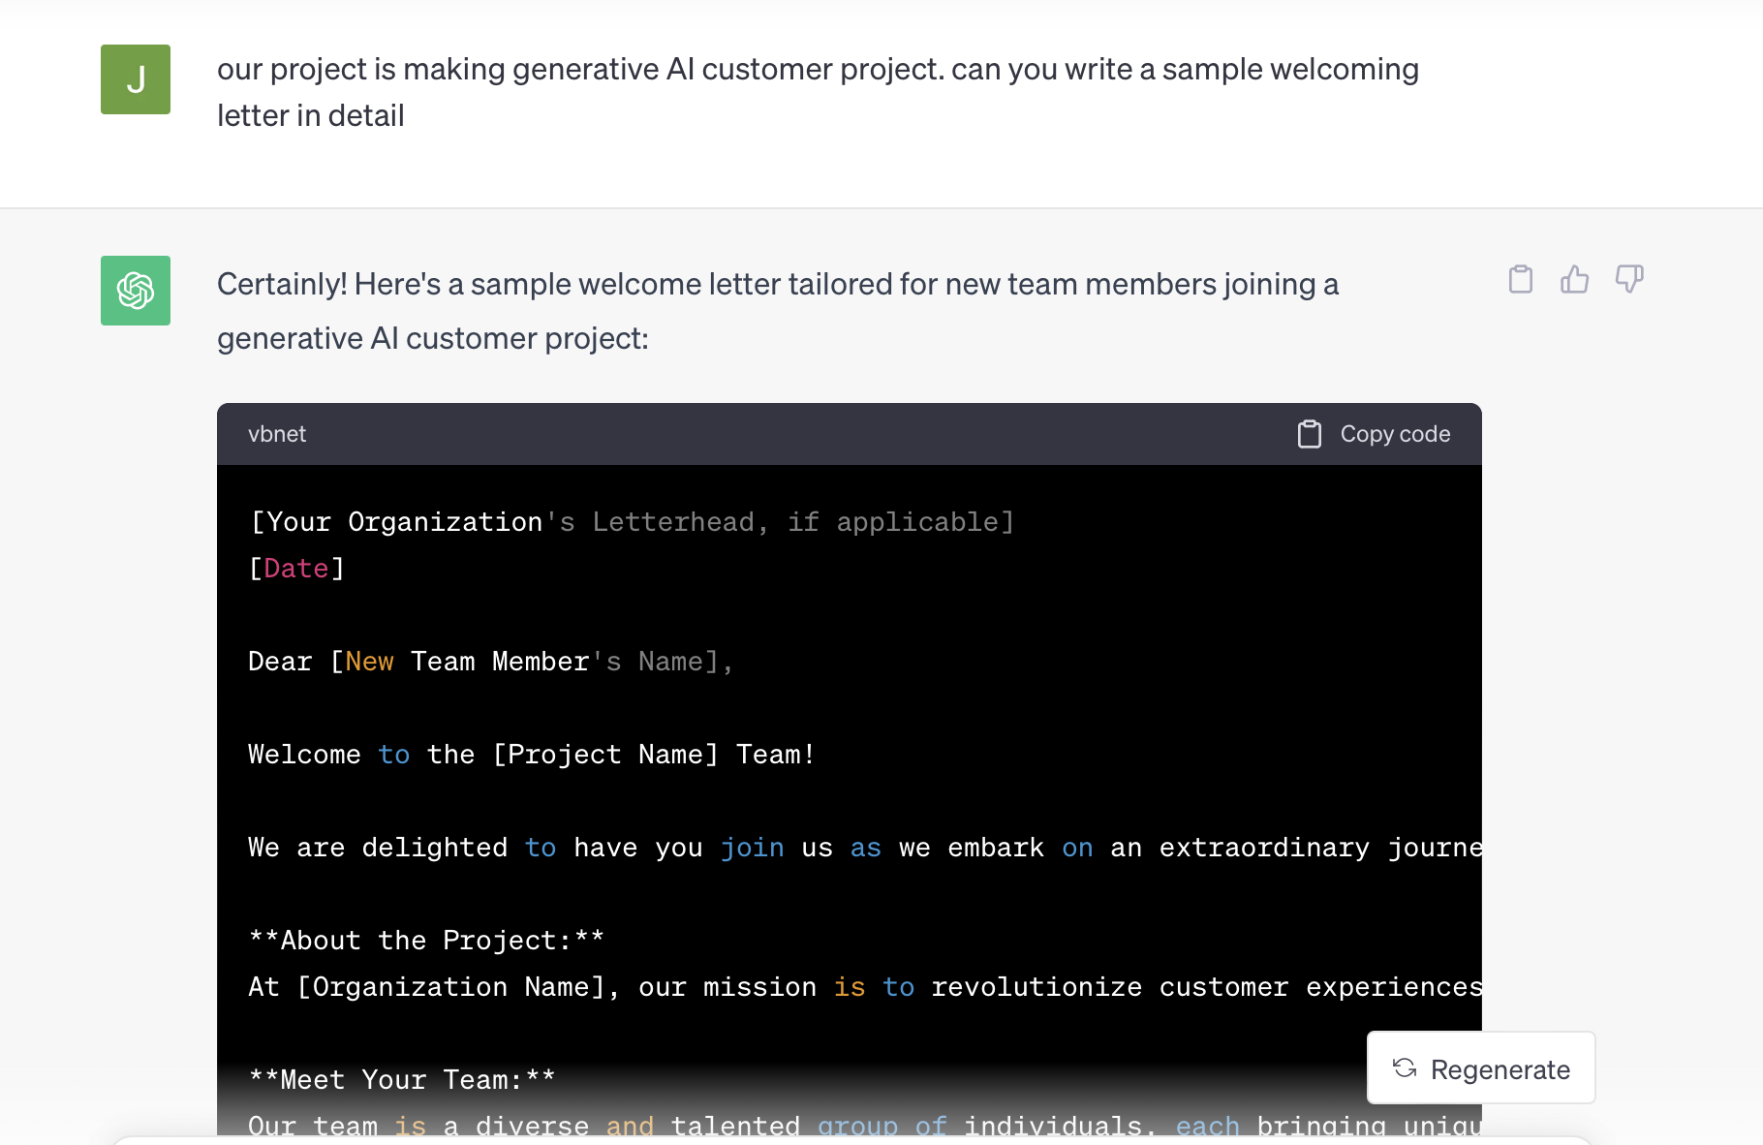
WELCOME LETTER

Slide 13
WHO WE ARE…

Slide 14
JOIN US!

Slide 15
THANK YOU!
DO YOU HAVE ANY QUESTIONS?
youremail@freepik.com
+91 620 421 838
yourwebsite.com
Please keep this slide for attribution

Slide 16
Fonts & colors used
This presentation has been made using the following fonts:
Candal
(https://fonts.google.com/specimen/Candal)
Cabin
(https://fonts.google.com/specimen/Cabin)
#000000
#fdfcfd
#dfe6ee
#a1b0ba
#7991d1
#4c5980
#ffd075
#eb9921
#d66ec0
#b345b5

Slide 17

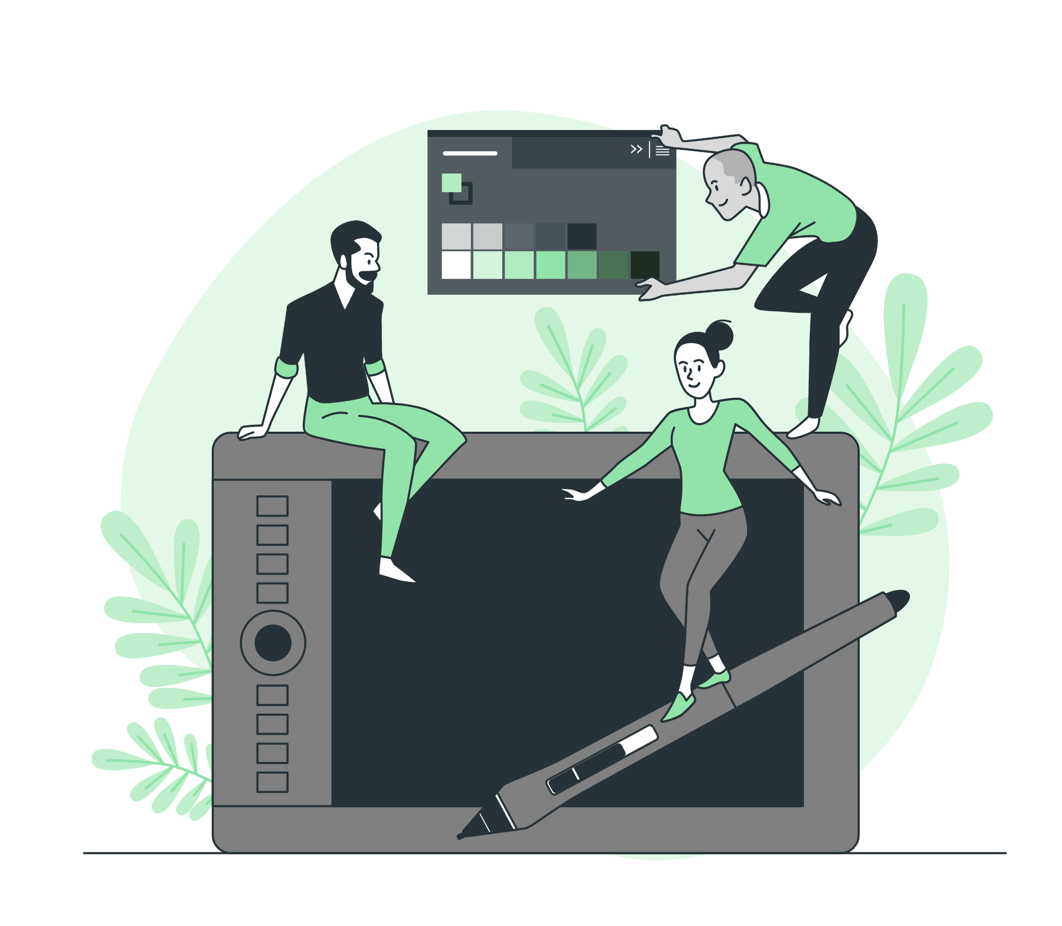



Storyset
Create your Story with our illustrated concepts. Choose the style you like the most, edit its colors, pick the background and layers you want to show and bring them to life with the animator panel! It will boost your presentation. Check out how it works.
Pana
Amico
Bro
Rafiki
Cuate

Slide 18
Use our editable graphic resources...
You can easily resize these resources without losing quality. To change the color, just ungroup the resource and click on the object you want to change. Then, click on the paint bucket and select the color you want. Group the resource again when you’re done. You can also look for more infographics on Slidesgo.

Slide 21
JANUARY
FEBRUARY
MARCH
APRIL
MAY
JUNE
PHASE 1
Task 1
Task 2
PHASE 2
Task 1
Task 2
JANUARY
FEBRUARY
MARCH
APRIL
PHASE 1
Task 1
Task 2

Slide 24
...and our sets of editable icons
You can resize these icons without losing quality.
You can change the stroke and fill color; just select the icon and click on the paint bucket/pen.
In Google Slides, you can also use Flaticon’s extension, allowing you to customize and add even more icons.

Slide 25
Educational Icons
Medical Icons

Slide 26
Business Icons
Teamwork Icons

Slide 27
Help & Support Icons
Avatar Icons

Slide 28
Creative Process Icons
Performing Arts Icons

Slide 29
Nature Icons

Slide 30
SEO & Marketing Icons

Slide 31


